Slide 1
Sunday Walk
Olivia Olsen
Digital Literacies

Slide 2
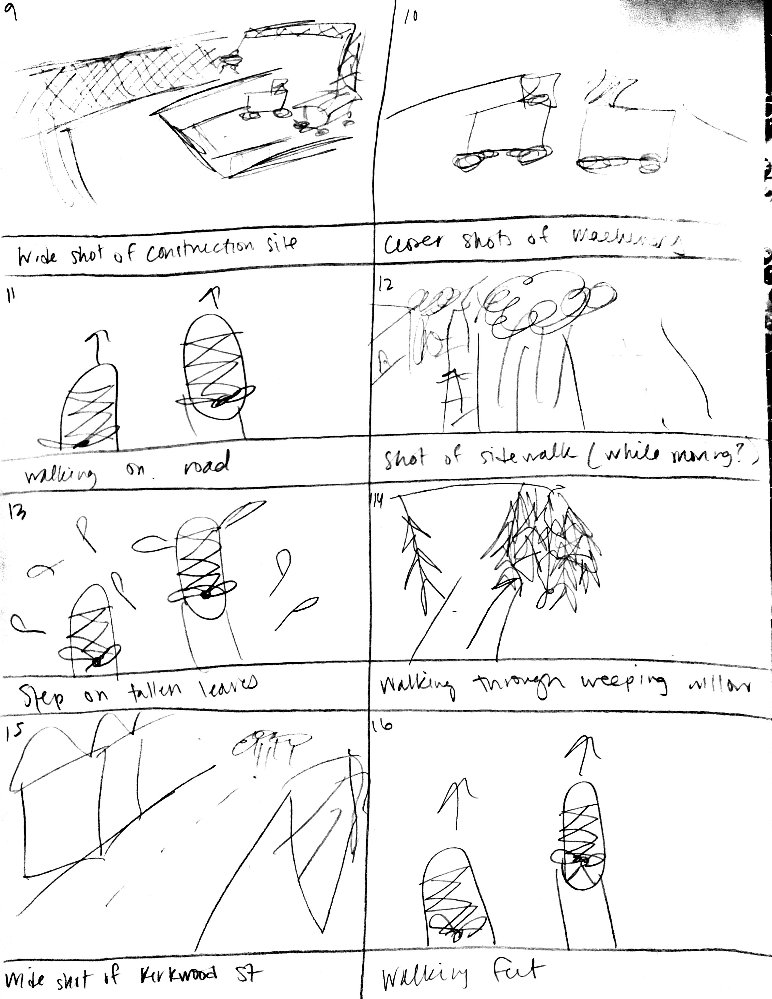

Slide 3
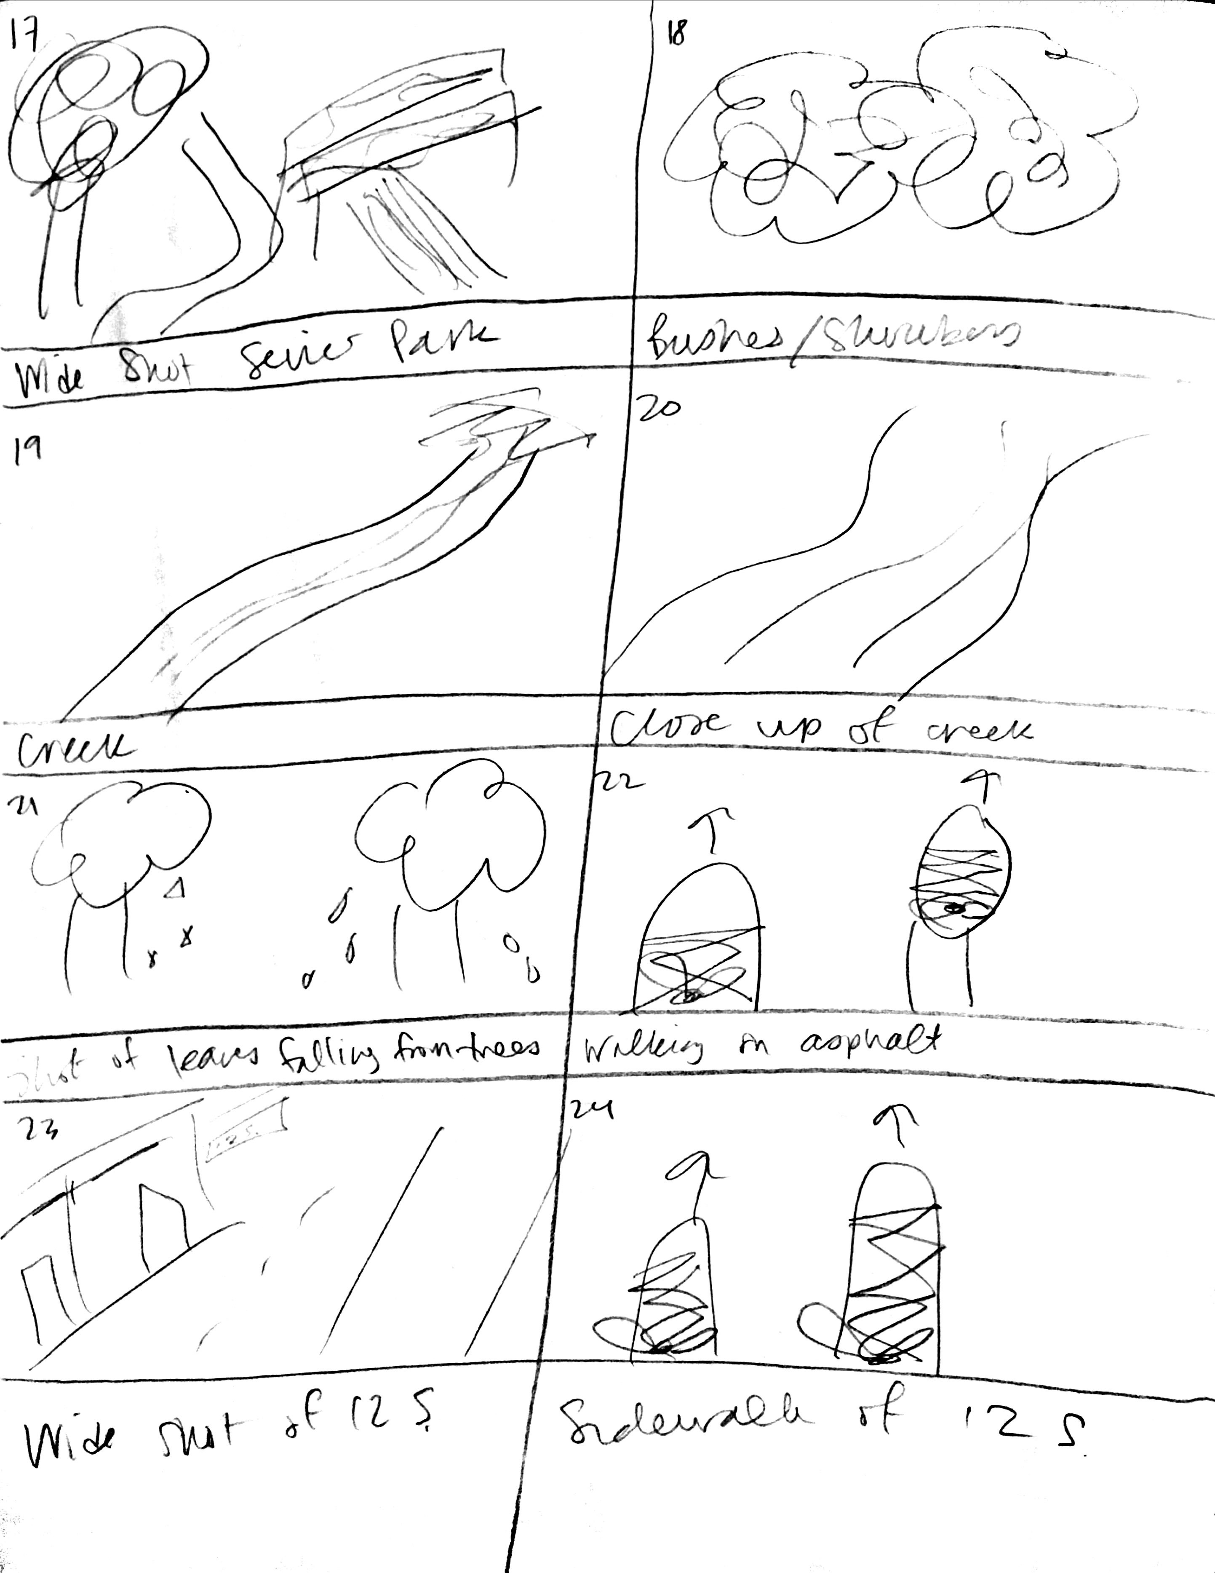

Slide 4
sunday walk
https://youtu.be/xcH6nBqFqJ0

Slide 5
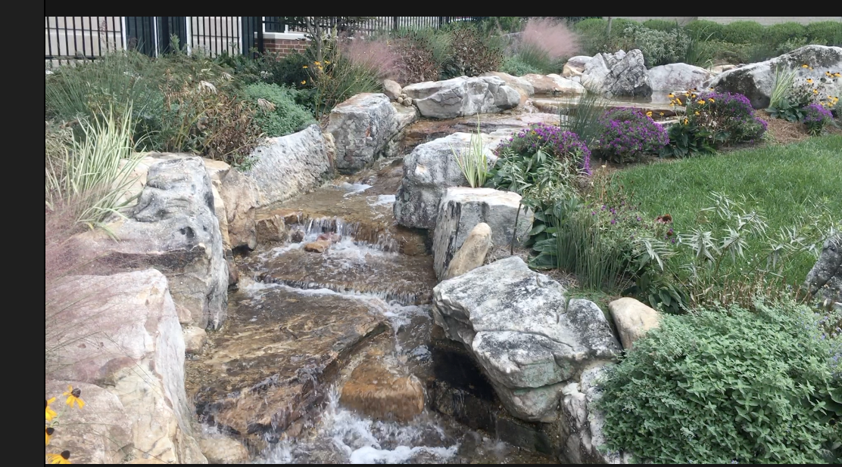
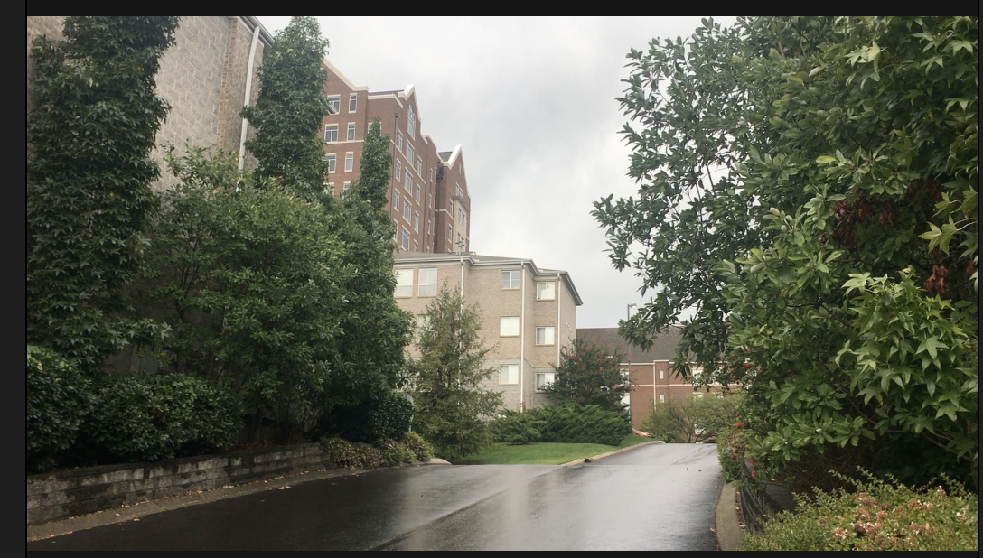
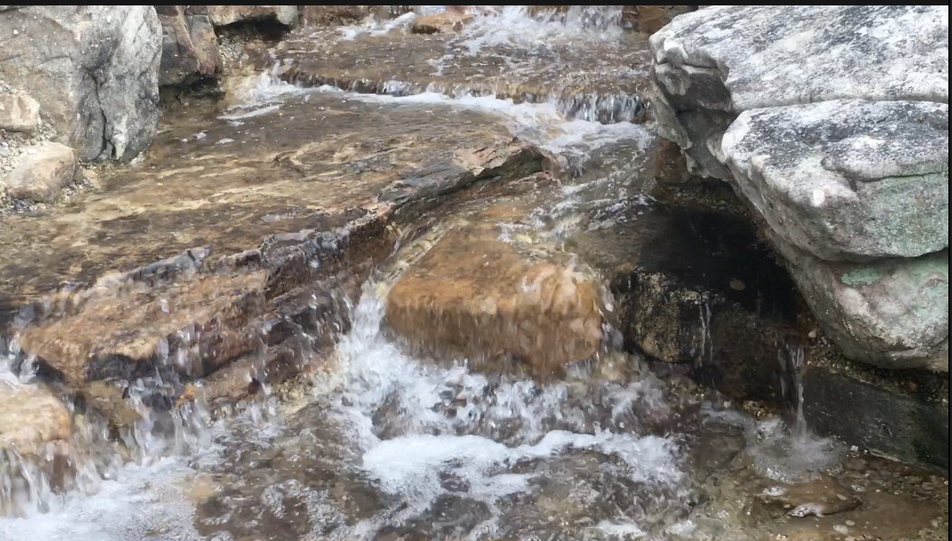
Visual Mode
From point-of-view of walker who was also the person filming. Wide and full shots as well as shots with panning help portray a realistic perspective from a walker’s eyes.

Slide 6
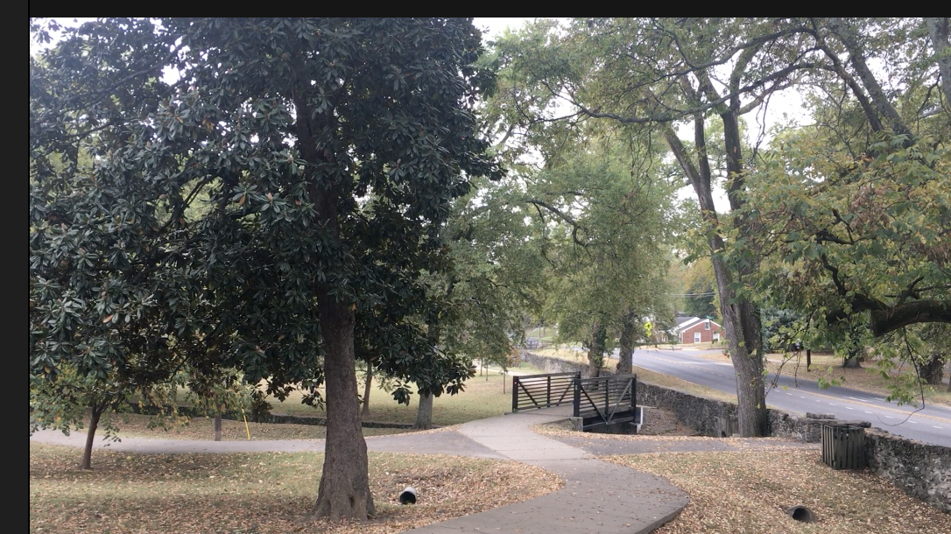
Audio Mode
Usage of ambient noise from outdoors and conversations from people in the walk adds realism and a calming tone to the video (e.g. rain sounds, water sounds)

Slide 7
Linguistic Mode
Signifies beginning and end of video; also conveyed through conversations among subjects during the walk.

Slide 8
Design Elements
Alignment: Attention to Rule of 3’s in full/wide shots; feet centered during walking shots
Repetition: Shots of walking feet; Tall Hall staircase from above and below.
Helps further plot
Adds cohesion throughout video

Slide 9
Why?
All design strategies and modes were used to portray the first-person perspective experience of a walk around Nashville. These tactics were used to encapsulate a walker’s point of view to not only entertain viewers, but to even calm them with the sounds and sights of a rainy day stroll.

